Slide 1
ROCK PAPER SCISSORS GAME
Using HTML, CSS, and JavaScript
Presented by: RAJESHWARI D
R.M.D ENGINEERING COLLEGE

Slide 2
Introduction
🎯 What is Rock Paper Scissors?
• A hand game played between two players.
• Each player simultaneously forms one of three shapes:
✊ Rock | ✋ Paper | ✌️ Scissors
• Rules:
- Rock beats Scissors
- Scissors beats Paper
- Paper beats Rock

Slide 3
Project Objective
📌 Objective:
To create an interactive browser-based Rock Paper Scissors game
where the user plays against the computer.

Slide 4
Technology Stack
🛠 Technologies Used:
• HTML – To create the basic structure
• CSS – For designing and styling the game
• JavaScript – To add game logic and interactivity

Slide 5
Project Structure
📁 Files Included:
• index.html → Structure and buttons
• style.css → Styling the layout and buttons
• script.js → Logic for choice, winner calculation, and display

Slide 6
Features
✨ Game Features:
✔️ Choose Rock, Paper, or Scissors
✔️ Computer selects a random choice
✔️ Result displayed instantly
✔️ Easy-to-use UI with emoji buttons
✔️ Responsive and colorful design

Slide 7
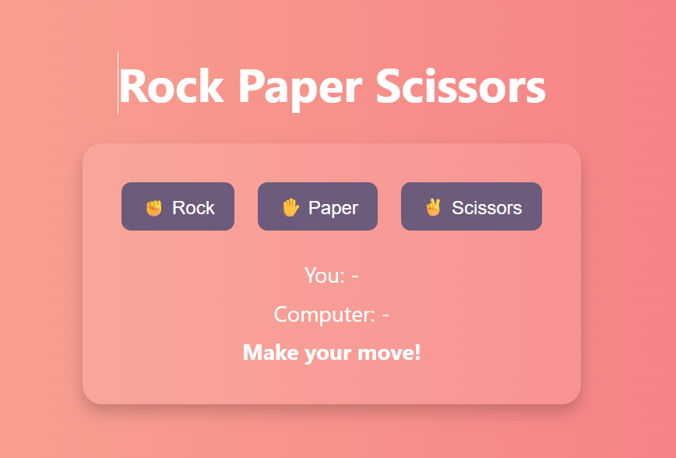
Game Interface
• Includes three buttons
• Displays user & computer choices
• Shows winner after each round

Slide 8
How It Works
⚙️ Game Flow:
1️⃣ User clicks a button (rock/paper/scissors)
2️⃣ JavaScript captures the choice
3️⃣ Computer randomly selects a choice
4️⃣ Logic compares both and determines winner
5️⃣ Result is displayed dynamically

Slide 9
Core JavaScript Logic
function getWinner(player, computer) {
if (player === computer) return 'draw';
if (
(player === 'rock' && computer === 'scissors') ||
(player === 'scissors' && computer === 'paper') ||
(player === 'paper' && computer === 'rock')
) return 'player';
return 'computer';
}

Slide 10
Challenges Faced
⚠️ Challenges:
• Managing choice comparison logic
• Styling buttons with emojis
• Keeping layout responsive
• Displaying clean output after each round

Slide 11
Conclusion
• Fun and interactive web game
• Strengthened JS logic skills
• Improved front-end design with CSS
• Learned DOM manipulation and event handling

Slide 12
THANK YOU

